Slide 1




University Institute of Engineering
Department of Computer Science & Engineering
COMPUTER ORGANIZATION & ARCHITECTURE
(23CST-204/23ITT-204)
ER. SHIKHA ATWAL
E11186
ASSISTANT PROFESSOR
BE-CSE

Slide 2
INSTRUCTION TYPES
Instructions are a set of machine language instructions that a particular processor understands and executes. A computer performs tasks on the basis of the instruction provided.
An instruction which is of 16-bit comprises of groups called fields. These fields include:
The Operation code (Opcode) field which specifies the operation to be performed is of 3 bits (12 to 14).
The Address field which contains the location of the operand, i.e., register or memory location is of 12 bits (0 to 11).
The Mode field which specifies how the operand will be located is of 1 bit (15th).

Slide 3
15 14 11 0
Mode (I) | Opcode | Operand/ address of operand
There are basically three types of instructions:
Register reference instructions
Memory Reference Instructions
3. Input Output Instructions

Slide 4
Register Reference Instructions are a class of instructions designed to operate directly on the processor's registers, without accessing memory.
These instructions are used to perform operations like data transfer, arithmetic, logical operations, and control tasks within the CPU.
Direct Register Access: Operate directly on CPU registers rather than involving memory locations.
Efficient Execution: Typically faster than memory-reference instructions since they do not require additional memory access cycles.
Simpler Encoding: These instructions are often simpler in terms of opcode and operand specification.

Slide 5

Opcode=111, I=0
The Register-reference instructions are represented by the Opcode 111 with a 0 in the leftmost bit (bit 15) of the instruction.
A Register-reference instruction specifies an operation on or a test of the AC (Accumulator) register.
Advantages
1. Faster Execution: Registers are faster to access than memory.
Reduced Memory Bottleneck: Fewer memory accesses reduce overall processing time.
Compact Instruction Encoding: Register operations typically use shorter instruction formats.

Slide 6
Disadvantages
Limited Scope: Register reference instructions only operate on data stored in registers, requiring extra instructions to load/store data from memory, increasing overall instruction count.
Register Dependency: They rely heavily on the availability of registers, which can be limited in number, potentially causing inefficiency in register-constrained architectures.
Complex Register Management: Managing data in multiple registers during complex operations can lead to increased programming complexity and errors.

Slide 7
Examples in Various Architectures
8085 Microprocessor (Accumulator-based):
CMA: Complement the content of the accumulator.
RLC: Rotate the content of the accumulator left.
x86 Assembly (General-purpose registers):
MOV AX, BX: Copy the content of BX into AX.
INC AX: Increment the value in AX.

Slide 8
Memory Reference Instructions are instructions that perform operations involving data stored in the main memory.
These instructions require interaction with the memory unit, making them slower than register reference instructions due to the additional time required for memory access.
Instruction Format: Typically include a memory address or a mechanism to compute one (e.g., direct, indirect addressing).
Primary Operations:
Reading data from memory.
Writing data to memory.
Performing operations where one or more operands are in memory.

Slide 9

Opcode=000 through 110
In Memory-reference instruction, 12 bits of memory is used to specify an address and one bit to specify the addressing mode 'I'.
Advantages
1. Flexibility: Allow operations involving large datasets that cannot fit in registers.
2. Support Complex Operations: Useful for working with arrays, structures, and dynamic data.

Slide 10
Disadvantages
Slower Execution: Accessing memory is slower than accessing registers.
Higher Power Consumption: Memory operations consume more energy compared to register operations.
Examples in Various Architectures
8085 Microprocessor:
LDA 2000H: Load the accumulator with the content of memory location 2000H.
STA 3000H: Store the content of the accumulator into memory location 3000H.
ADD M: Add the content of the memory location pointed to by the HL register pair to the accumulator.

Slide 11
2. x86 Architecture:
MOV AX, [1000H]: Load the content of memory address 1000H into the AX register.
MOV [2000H], BX: Store the content of BX into memory address 2000H.

Slide 12
3. Input/Output (I/O) Instructions are used to transfer data between the processor and peripheral devices like keyboards, printers, displays, and storage devices.
These instructions enable communication between the CPU and I/O devices through I/O ports.
Device Communication: Facilitate data transfer between the CPU and external devices.
Addressing: Port-based Addressing can be used which uses specific addresses (I/O ports) for I/O devices and Memory-mapped I/O which treats device addresses as part of the memory address space.
Modes of Data Transfer: Programmed I/O, Interrupt-driven I/O, Direct Memory Access (DMA). These modes of data transfer will be discussed in detail in later unit.

Slide 13

Opcode=111, I=1
Just like the Register-reference instruction, an Input-Output instruction does not need a reference to memory and is recognized by the operation code 111 with a 1 in the leftmost bit of the instruction. The remaining 12 bits are used to specify the type of the input-output operation or test performed.
Advantages of I/O Instructions
Efficient Data Management: Simplify communication with devices.
Flexibility: Support various addressing schemes and data transfer modes.
Reduced Latency: With techniques like interrupt-driven I/O and DMA.

Slide 14
Disadvantages
Programmed I/O Overhead: Polling wastes CPU time.
Complexity: Managing multiple I/O devices can be challenging.
Dependency: Device-specific instructions limit portability.
Examples in Various Architectures
8085 Microprocessor
Input: IN 05H (Reads data from port 05H into the accumulator).
Output: OUT 06H (Writes data from the accumulator to port 06H).
x86 Architecture
Input: IN AL, DX (Reads data from the port specified in DX into AL).
Output: OUT DX, AL (Writes the data in AL to the port specified in DX).

Slide 15
Note:
The three operation code bits in positions 12 through 14 should be equal to 111. Otherwise, the instruction is a memory-reference type, and the bit in position 15 is taken as the addressing mode I.
When the three operation code bits are equal to 111, control unit inspects the bit in position 15. If the bit is 0, the instruction is a register-reference type. Otherwise, the instruction is an input-output type having bit 1 at position 15.

Slide 16
ADDRESSING MODES
The operation field of an instruction specifies the operation to be performed. This operation must be executed on some data stored in computer registers or memory words. The way the operands are chosen during program execution is dependent on the addressing mode of the instruction.
The addressing mode specifies a rule for interpreting or modifying the address field of the instruction before the operand is actually referenced.
Computers use addressing mode techniques for the purpose of accommodating one or both of the following provisions:
To give programming versatility to the user by providing such facilities as pointers to memory, counters for loop control, indexing of data, and program relocation.
To reduce the number of bits in the addressing field of the instruction.

Slide 17

Effective Address (EA): The effective address refers to the address of an exact memory location in which an operand’s value is actually present. Let us now explain all of the addressing modes.
Instruction Format

Slide 18
Implied Mode: In this mode the operands are specified implicitly in the definition of the instruction. For example, the instruction "complement accumulator" is an implied- mode instruction because the operand in the accumulator register is implied in the definition of the instruction. In fact, all register reference instructions that use an accumulator are implied-mode instructions.
Immediate Mode: In the immediate mode, we specify the operand in the instruction itself. Or, in simpler words, instead of an address field, the immediate-mode instruction consists of an operand field. An operand field contains the actual operand that is to be used in conjunction with an operation that is determined in the given instruction. The immediate-mode instructions help initialize registers to a certain constant value.

Slide 19
3. Register Mode: Also called Register Direct Mode. In the register mode, the operands exist in those registers that reside within a CPU. In this case, we select a specific register from a certain register field in the given instruction. The k-bit field is capable of determining one 2k register.
4. Register Indirect Mode: In the register indirect mode, the instruction available to us defines that particular register in the CPU whose contents provides the operand’s address in the memory. In simpler words, any selected register would include the address of an operand instead of the operand itself.
The reference to a register is equivalent to specifying any memory address. The pros of using this type of instruction are that an instruction’s address field would make use of fewer bits to select a register than would be require when someone wants to directly specify a memory address.

Slide 20
Autoincrement or Autodecrement Mode: The Autodecrement or Autoincrement mode is very similar to the register indirect mode. The only exception is that the register is decremented or incremented before or after its value is used to access memory. When the address stored in the register defines a data table in memory, it is very crucial to decrement or increment the register after accessing the table every time. It can be obtained using the decrement or increment instruction.
Direct Address Mode: In the direct address mode, the address part of the instruction is equal to the effective address. The operand would reside in memory, and the address here is given directly by the instruction’s address field. The address field would specify the actual branch address in a branch-type instruction.

Slide 21
7. Indirect Address Mode: In an indirect address mode, the address field of an available instruction gives that address in which the effective address gets stored in memory. The control fetches the instruction available in the memory and then uses its address part in order to (again) access memory to read its effective address.
8. Indexed Addressing Mode: In the indexed addressing mode, the content of a given index register gets added to an instruction’s address part so as to obtain the effective address. Here, the index register refers to a special CPU register that consists of an index value. An instruction’s address field defines the beginning address of any data array present in memory.

Slide 22
The effective address (EA) in these modes is obtained from the following computation: EA= address part of instruction + content of CPU register
The CPU register used in the computation may be the program counter, an index register, or a base register. In either case we have a different addressing mode which is used for a different application.
9. Relative Address Mode: In relative addressing mode, the Effective Address (EA) of the operand is calculated by adding the content of the CPU register to the address part of the instruction word. Essentially, the effective address is the sum of the displacement (the immediate value specified in the instruction) and the value of the register. The address part of the given instruction is typically a signed number, which can be either negative or positive. The resultant effective address is relative to the address of the next instruction.
EA = Displacement + CPU Register

Slide 23
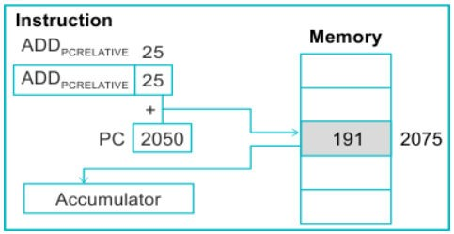
Here's a symbolic representation of relative addressing mode: X(PC)
The effective address for it can be calculated as follows: EA = X + (PC)
Because the operand addresses in this mode are found relative to the program counter, it's referred to as the relative address mode.

Slide 24
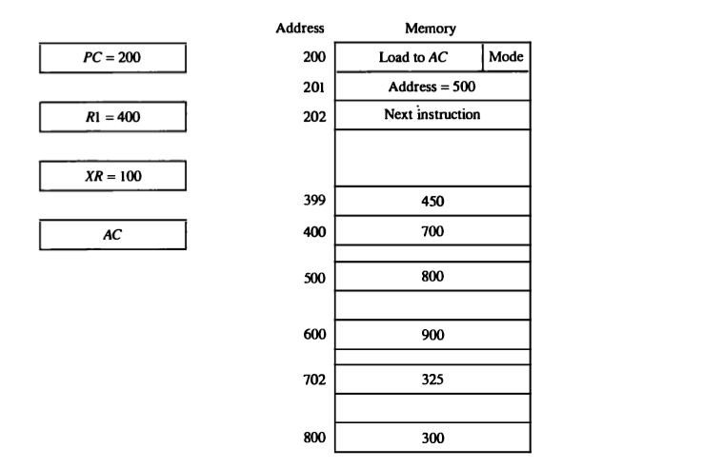
Numerical Example for Addressing Mode

Slide 25
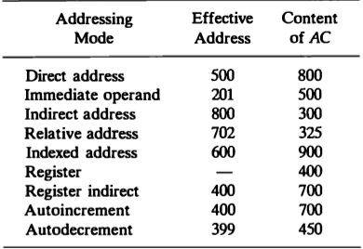

Slide 26
References
Reference Books:
J.P. Hayes, “Computer Architecture and Organization”, Third Edition.
Mano, M., “Computer System Architecture”, Third Edition, Prentice Hall.
Stallings, W., “Computer Organization and Architecture”, Eighth Edition, Pearson Education.
Text Books:
Carpinelli J.D,” Computer systems organization &Architecture”, Fourth Edition, Addison Wesley.
Patterson and Hennessy, “Computer Architecture”, Fifth Edition Morgaon Kauffman.

Slide 27
Reference Website
https://www.studytonight.com/computer-architecture/addressingmodes-instructioncycle
http://www.eie.polyu.edu.hk/~enyhchan/addrmode.pdf
Video References
https://www.youtube.com/watch?v=ol_g3Lt66xA
https://www.youtube.com/watch?v=_CH4cm5PhK8

